Slide 1
Tree based models
Model selection
Dataprep
Results
Finetuning

Slide 2
Model selection
Model | Overfitting | Interpretability | Handles High dimensionality | Slow to Train | Requires Tuning | Variable Selection Bias
CART (basic tree) | Yes | High | Poor | No | Yes (α pruning) | High – favors variables with many cut points
Conditional Inference Tree (ctree) | No | High | Moderate | Yes (when p*n is large) | No | Low – splits chosen via p-values
Bagging | Reduced | Low | Moderate | Yes | No | High – uses unadjusted CART trees
Random Forest | Reduced | Low | Good | Yes | No | Medium – random feature selection helps
Boosting (gbm) | Yes (if untuned) | Low | Moderate to good | Yes | Yes – needs tuning (e.g. shrinkage λ) | High – typically uses biased base trees
XGBoost | Reduced | Low | Excellent | No (optimized) | Yes – extensive tuning needed | High – unless special splitting method used

Slide 3
Random Forest – data preparation
Missing Values
Factorize classes and columns with characters

Slide 4
Random Forest - training
Based on the lectures:
mtry: √p for classification
Ntree: 500
Nodesize: min 1

Slide 5
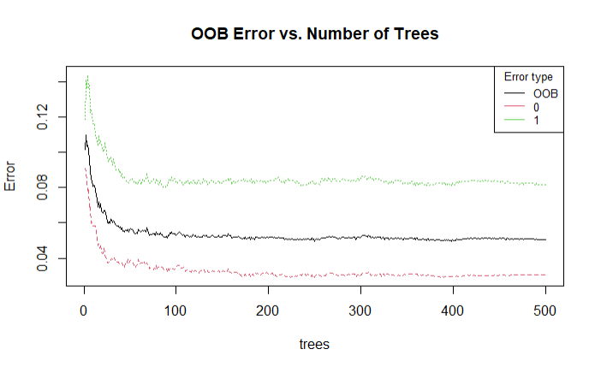
Checking the number of trees
Ntree = 500

Slide 6
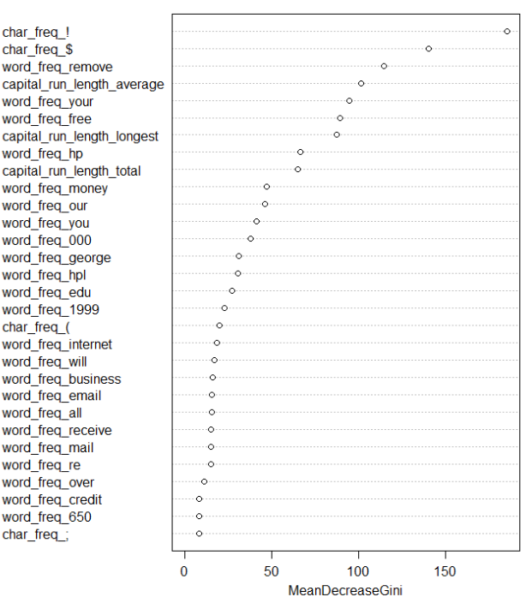
Results
Most important variables
False Positive Rate: 2.54 %
False Negative Rate: 7.96 %
Accuracy: 95.29 %

Slide 7
Get false positives below 1%
Retrieve the probabilities
Find the threshold that gives FP < 1%
→ This occurs when we set the the minimum probability for an observation to be classified as (1) (spam) to 0.66
Results:
False Positive Rate: 0.96 %
False Negative Rate: 14.65 %
Accuracy: 93.56 %
Optional: retraining the model with different weights

